Slide 1
Project 4

Slide 2
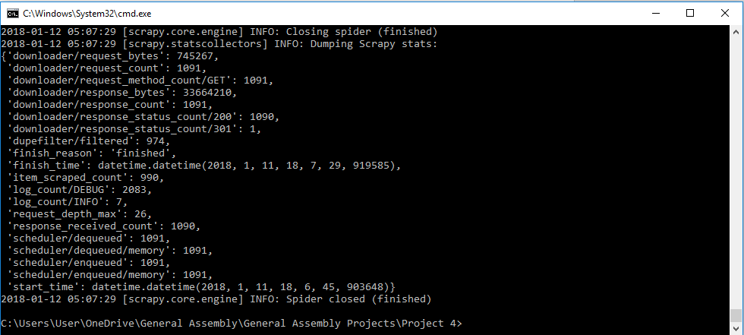
Scraped using Scrapy

Slide 3
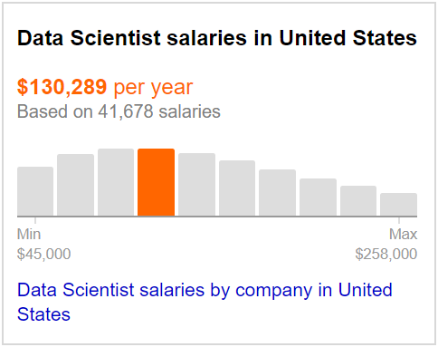
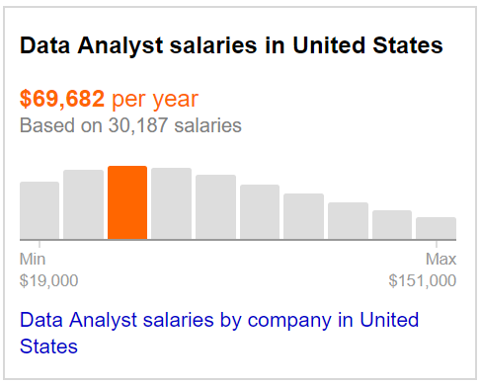
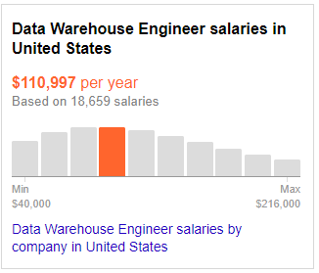
Comparing Salaries of Jobs – America
Data Scientist has a significantly higher median pay scale compared to Analysts and Engineers
PROBLEM 1: INDEED ONLY LETS YOU SCRAPE 1000 ENTRIES MAX

Slide 4

Seek ?

Slide 5
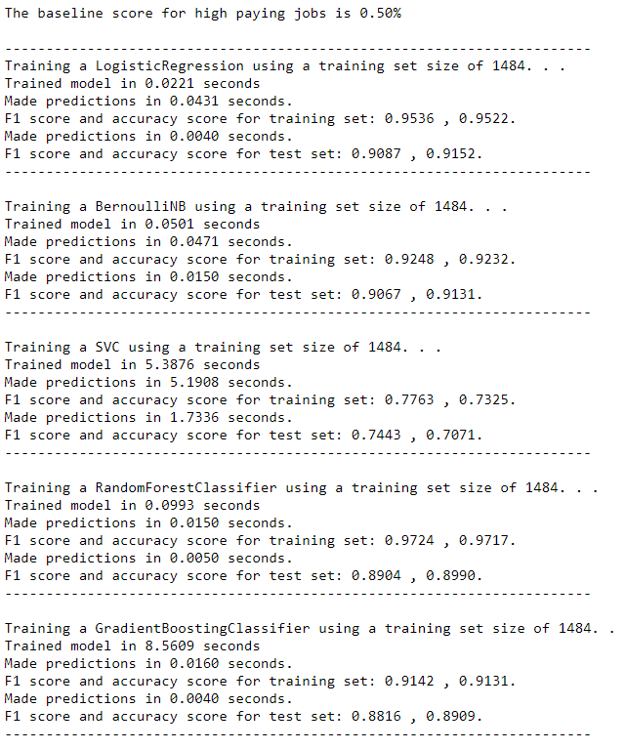
Predicting a Binary Pay Scale using Title/Summary
Used CountVectorizer
Logistic Regression is marginally better for both
Further used GridSearchCV to optimize.
PROBLEM 2: BASELINE 50%, NOT APPLICABLE TO REAL LIFE.

Slide 6
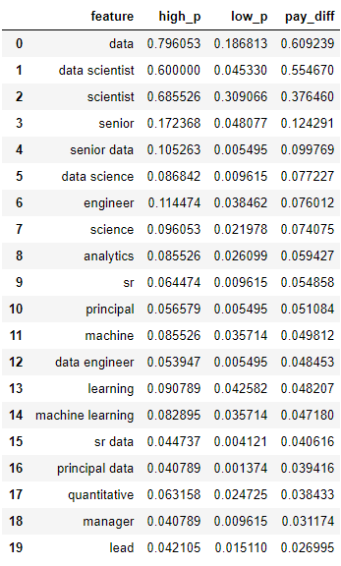
Using Naïve Bayes to determine probability of words given “pay”
Summaries: 20 most probable word given a HIGH pay rate
For the most part the words are very technical.

Slide 7
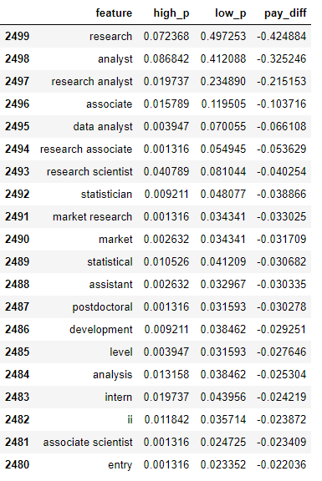
Using Naïve Bayes to determine probability of words given “pay”
Summaries: 20 most probable word given a LOW pay rate
Large contrast

Slide 8
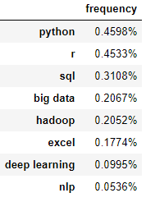
What skills come up the most?
Python & R comes up the most at 45%.
SQL skills frequently requested at 31%.
Big Data is needed ~ 20% of the time.

Slide 9
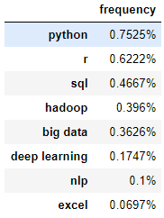
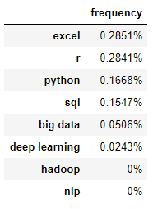
How about for High and Low paying jobs?
High
Low
Much lower focus on hard skills in high paying jobs compared to low paying jobs
The more technical terms such as Hadoop, NLP and Deep learning see next to no use at all

Slide 10
Insights – Overall Features
From the data it appears that there is a clear distinction between the keywords used for jobs that have high paying salaries vs jobs with low paying salaries.
High Paying Sal (Titles): Data, Scientist, Senior, Analytics
Low Paying Sal (Titles): Research, Analyst, Associate, Statistician
High Paying Sal (Summaries): Hard skills
Low Paying Sal (Summaries): Soft skills

